Slide 1
Gayton Village Meeting Regarding Solar Farm Application
28th August 2025
Notes:
28-aug-25 at 19:00

Slide 2
Introductions
Roger Clark
Carl Hamilton
Pro Solar Presenters

Slide 3
Structure of Meeting
The first speaker will be councillor Roger Clark who will give a presentation to remind us all of the history of the Solar Farm application and outline the parish council submission opposing the application.
Carl Hamilton will outline the changes proposed by Anesco.
Following this there will be an opportunity for those in favour to speak. We asked them in advance to book their slot in the overall agenda.
  All speakers will have a maximum of 15 minutes to speak after which they will be asked to stop, even if they haven’t finished.
  The PC will advise individuals and groups how they can make their voice heard, especially if they disagree with the PCs point of view.
The meeting will then close but coffee will be available to enjoy over an informal chat.

Slide 4
History
Councillor Roger Clarke will now take you through a short history of the project to date

Slide 5
Submission to WNC (West Northants Council)
Roger will now explain what we submitted to WNC on the 22nd August 2025

Slide 6
2025 submission by Anesco
The following slides were all provided by Anesco and have not been altered in any way.

Slide 7
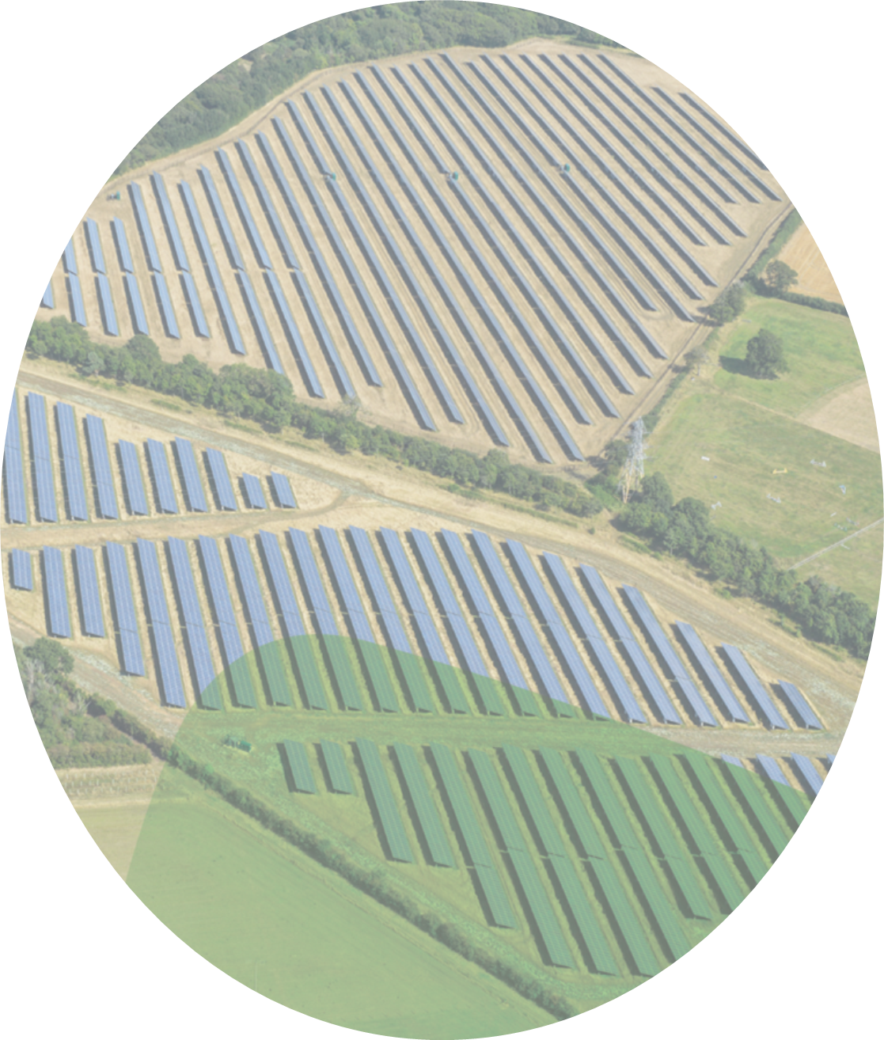

Gayton Solar
One Step Closer to Achieving Net Zero and Addressing the UK Climate Emergency

Slide 8
Introduction
Anesco are preparing a new planning application to be submitted in late June early July.
The decision to submit a new application has been made after considering the progress of the Judicial Review and in the context of significant reforms to the UK’s grid connection process.
These 2 major factors have resulted in a shortened timeframe for a planning submission which has compromised the ability to hold a comprehensive community consultation programme.

Slide 9
UK Grid Connection Reform
The National Energy System Operator (NESO) launched significant reforms to the UK’s electricity grid connection process in 2025 to address long-standing delays and inefficiencies.
Key Reform Measures
  Applications will be assessed during designated windows.
    First window closes on 29th July 2025, the next being approximately 6 months later
    Structured steps take place to ensure only viable and strategically aligned projects move forward.
    Evidence must be submitted to demonstrate progress, importantly a validated planning application is a key criteria for this window only, as it protects the project and guarantees a grid offer.
    The project being validated along with the current grid connection agreement for Gayton ensures the project is given a high priority position in the reassessment of the connection queue. The queue consists of all projects that have requested a grid connection and meet the criteria below.
  Projects must meet 2 criteria
    Gate 2 Readiness Criteria: Demonstrating technical readiness.
    Gate 2 Strategic Alignment Criteria: Aligning with national energy strategies in the Clean Power 2030 Plan

Slide 10
Key Dates
Early May 2025 decision taken to pause the legal challenge and stop all work related to the judicial review.
To protect the grid connection a planning application needs to be validated by 29th July.
Mid-May review site layout and amend to address the concerns on the visual impacts from the Turnover Bridge and the Grand Union Canal Conservation Area, which was flagged in the previous application process.
Late May contract consultants to update reports and prepare for planning submission. This is ongoing at speed.

Slide 11
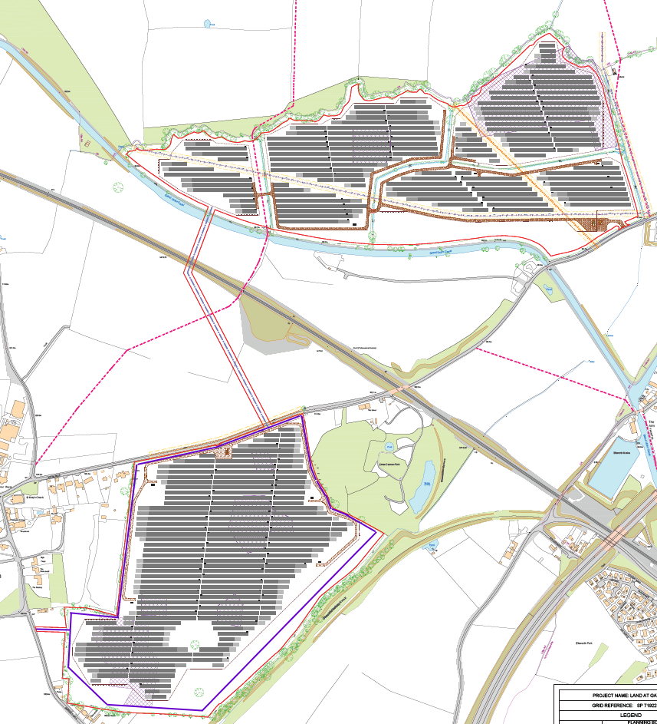
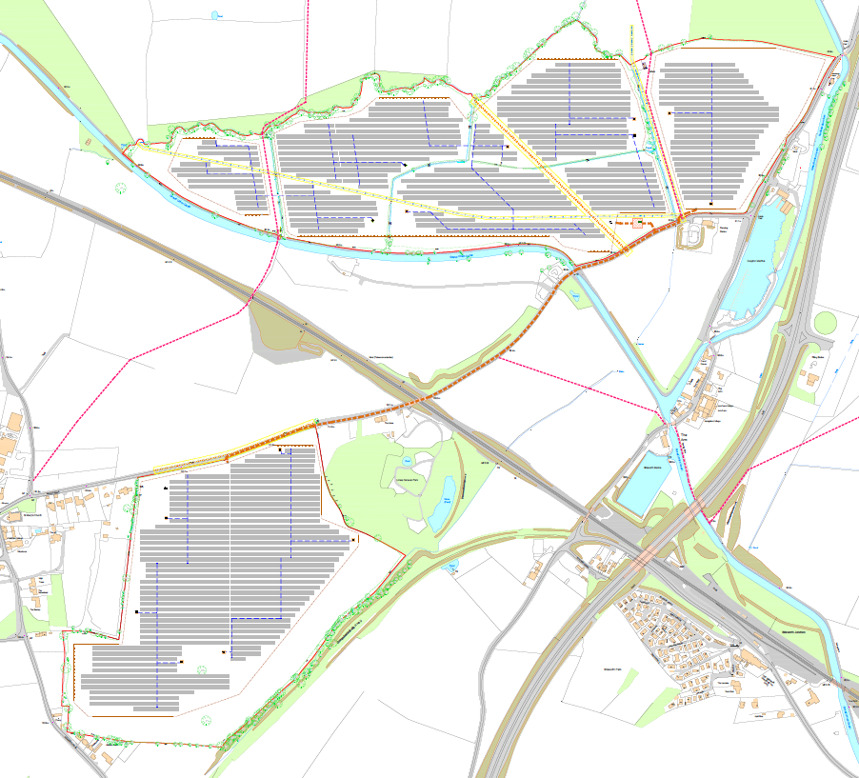
Comparison of Old and Proposed Layout
Total Installed Capacity | 50 MW
Total Installed Capacity | 46 MW
Panels removed from areas highlighted in red. This addresses the impact on the Turnover Bridge and the Grand Union Canal Conservation Area.

Slide 12
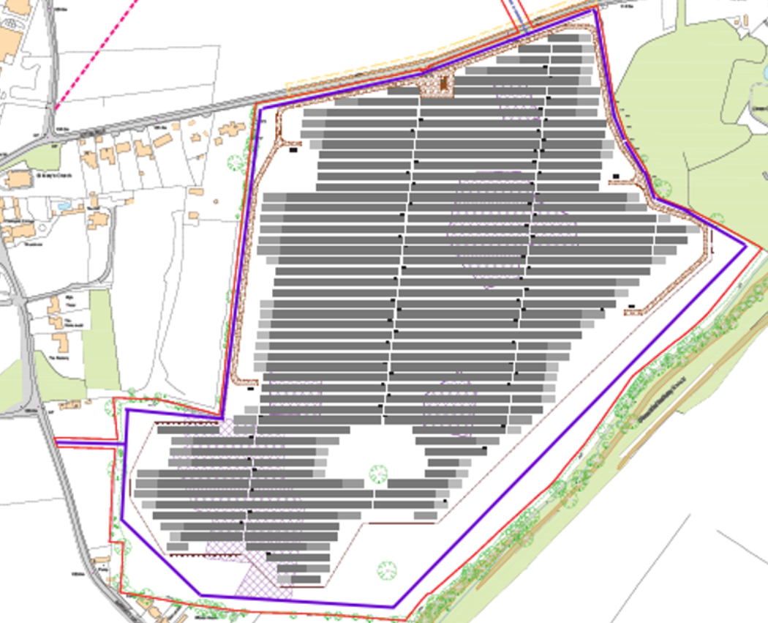
Proposed Walking Route around Southern parcel of Land
Proposed Route between field boundary and Solar fence line

Slide 13
Benefits from the proposed scheme
A site-specific Biodiversity plan, and Landscape Strategy, will be devised to cover the lifetime of the project
New sections and enhancements of native hedgerows, trees, and wildflower meadow will be looked at and planted if suitable around the site
Bird, owl and bat box and hibernacula's can be introduced
Opportunity for the community to benefit from wider planting and enhancements
Biodiversity and Landscape Enhancements
Opportunities for the local community to be involved in ongoing ecological maintenance
At Anesco we feel it is important to help nurture young people and solar schemes like this offer opportunities for educational school visits to site with Anesco engineers to understand the importance of Solar for a sustainable net zero grid network in the UK
Education
Anesco are committed to assisting local communities and are happy to offer support, reasonable funding and assist in community projects. For example, Anesco could:
Help with the LED lighting in the local area
Help with local projects, such as a path or gate that needs upgrading/fixing, or a new fence installed around a playground.
A new walking route is to be added to the southern parcel of the land around the perimeter of the solar panels for the local community to utilise.
We would welcome conversations around specific project support in the area
Community
Confidential June 2025

Slide 14






Thank you for your time.
Please contact projectdevelopment@anesco.co.uk
Home Page - Anesco renewable energy and energy efficiency

Slide 15
Presentations by those in favour
The only person who has contacted us to date is Mr Jens Buus who unfortunately cannot be with us tonight
However we have copies of his “Solar Power Facts” paper which you are welcome to pick up

Slide 16
Summary and Close
Sum up main points
Ask for a show of hands
Questions from the floor
Close meeting
Coffee and informal discussion

