Slide 1
Gayton Neighbourhood Development Plan Survey: Graphical
Survey Closed on Sunday, May 25, 2025

Slide 2
161
Total Responses
Date Created: Tuesday, January 28, 2025
Complete Responses: 161

Slide 3
Q1: Are there any additional services and facilities you would like to see? (Please select all the options that apply)
Answered: 153 Skipped: 8

Slide 4
Q2: How many new homes should we plan for in Gayton
Answered: 145 Skipped: 16

Slide 5
Q3: How should we plan for housing growth in Gayton? (Please select all that apply)
Answered: 137 Skipped: 24

Slide 6
Q4: Please identify the THREE most important priorities for housing in the parish?
Answered: 132 Skipped: 29

Slide 7
Q5: Does your household expect to want, or need, to move within the parish in the next ten years?
Answered: 138 Skipped: 23

Slide 8
Q6: How many bedrooms would that household want or need?
Answered: 28 Skipped: 133

Slide 9
Q7: When would the household want or need to move?
Answered: 29 Skipped: 132

Slide 10
Q8: Do you own or run a business?
Answered: 139 Skipped: 22

Slide 11
Q11: What size is your business?
Answered: 31 Skipped: 130

Slide 12
Q12: What type of activity is your business engaged in?
Answered: 31 Skipped: 130

Slide 13
Q13: Are the business premises also located at your home?
Answered: 30 Skipped: 131

Slide 14
Q14: What is the age of your business?
Answered: 30 Skipped: 131

Slide 15
Q15: Does your business engage in e-commerce? (Please select all the options that apply)
Answered: 29 Skipped: 132

Slide 16
Q16: Do you plan to close or transfer your business in the next 5 to 10 years?
Answered: 30 Skipped: 131

Slide 17
Q17: Do you require additional business space in the next 5 to 10 years?
Answered: 30 Skipped: 131

Slide 18
Q18: How likely are you to set up a new business within the parish in the next 5 to 10 years?
Answered: 36 Skipped: 125

Slide 19
Q19: Which of the following economic activities would you support in Gayton (Please select all the options that apply)
Answered: 131 Skipped: 30

Slide 20
Q20: Is outdoor recreation important to you?
Answered: 138 Skipped: 23

Slide 21
Q21: Do you use the local footpaths and bridleways?
Answered: 137 Skipped: 24

Slide 22
Q22: Some of your Council Tax goes towards supporting the maintenance of footpaths, the village green and the children's play area. Do you consider this a good use of your tax?
Answered: 137 Skipped: 24

Slide 23
Q23: Do you use the allotments?
Answered: 139 Skipped: 22

Slide 24
Q24: Do you consider an allotment an important asset?
Answered: 137 Skipped: 24

Slide 25
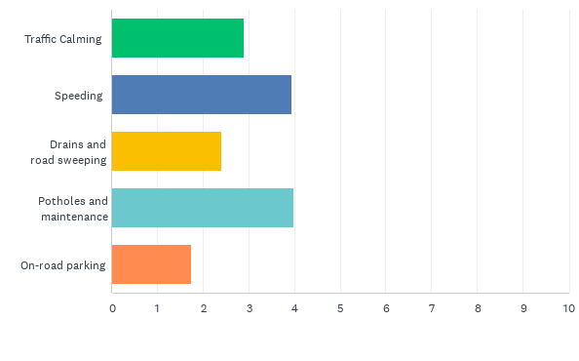
Q26: Please rank in order of importance
Answered: 140 Skipped: 21

Slide 26
Q27: Do you think the roadside footpaths are safe to use and fit for purpose?
Answered: 137 Skipped: 24

Slide 27
Q28: Would you like to see steps taken to protect and encourage wildlife habitat?
Answered: 138 Skipped: 23

Slide 28
Q29: Do you support installing extra lights in areas that require greater illumination?
Answered: 137 Skipped: 24

Slide 29
Q30: If yes, would you be willing to pay for more lighting on your Council Tax?
Answered: 109 Skipped: 52

Slide 30
Q31: Which of the following do you think new housing should have?
Answered: 128 Skipped: 33

Slide 31
Q32: Do you support the use of agricultural land to accommodate a solar farm?
Answered: 137 Skipped: 24

Slide 32
Q33: Do you support using agricultural land to accommodate wind turbines?
Answered: 133 Skipped: 28

Slide 33
Q38: Where would you prefer to be laid to rest
Answered: 133 Skipped: 28

Slide 34
Q39: Do you live in the Village?
Answered: 124 Skipped: 37
Yes (Without Address)
Yes (With Address)

Slide 35
Q40: What is your age?
Answered: 134 Skipped: 27

